Slide 1
Money, Price Level and Inflation
Syed A. Mamun, PhD, FCMA
Professor of Finance
Department of ESS
BRAC University

Slide 2
What is money?
Money is anything that is generally accepted as a means of payment.
A means of payment is something used to settle a debt or transaction.
Money performs three major economic functions:
Medium of Exchange
Unit of Account
Store of Value

Slide 3

Examples
Currency
Money.
Bank deposits
Generally considered money because they can be used to make payments.
Credit card
Not money. A credit card provides access to borrowing; it is not itself a means of payment in the economic sense.
House
Not money. It is an asset and store of wealth but is not generally accepted as a means of payment.
Gold
Can function as a store of value, but modern gold is generally not money because it is not the normal means of payment.

Slide 4
Why Do We Need Banks?
Depository institutions perform important economic functions.
  Major functions include:
  Creating liquidity
  Pooling financial resources
  Reducing transaction costs
  Monitoring borrowers
  Managing and diversifying risk
  Transforming deposits into loans

Slide 5
Functions of Central Bank
issuing currency;
1
acting as banker to the government;
2
acting as banker to commercial banks;
3
maintaining financial stability;
4
influencing the money supply;
5
conducting monetary policy;
6
acting as lender of last resort.
7

Slide 6

How banks create money (cont..)
Banks create money primarily by making loans, not by printing cash. This process is often called money creation through fractional-reserve banking or deposit creation.
Three steps
  Deposit money in a bank
  The Bank makes a loan after meeting its reserve requirement
  The process repeats
Central banks create base money (cash and reserves).
Commercial banks create most everyday money by making loans that simultaneously create matching deposits.
Money is also destroyed when loans are repaid: as the borrower repays the principal, the corresponding bank deposit is extinguished, reducing the money supply.

Slide 7
Bank’s Balance Sheet
Assets | Liabilities + Owners' Equity
Reserves | Deposits
Loans | Borrowings
Securities | Bank capital
Other assets | Other liabilities

Slide 8
How banks create money (cont..)
Round | New Deposit (Tk.) | Required Reserve 10% | New Loan (Tk.)
1 | 1,000.00 | 100.00 | 900.00
2 | 900.00 | 90.00 | 810.00
3 | 810.00 | 81.00 | 729.00
4 | 729.00 | 72.90 | 656.10
5 | 656.10 | 65.61 | 590.49
... | ... | ... | ...
New loan leads to new bank deposit
Suppose a customer deposits Tk.1,000 into Bank A, and its required reserve ratio is 10%.

Slide 9
Money Multiplier and Money Creation
The money multiplier is an economic concept that shows how an initial bank deposit creates a larger total increase in the country's money supply through repeated rounds of lending.
Money Multiplier (m) = 1/ Reserve ratio
Total money creation ( deposit) = Initial deposit ( bank reserve) x m
Or, change of deposit = m x initial change of reserve
Here, Money Multiplier = 1/.10 = 10,
So, Total deposit creation = Tk 1000 x 10 = 10,000.

Slide 10
Does the bank create money "out of thin air"?
Banks create deposit money, which is the kind of money most people use through checking accounts and electronic payments.
They cannot create unlimited money because they are constrained by:
Capital requirements (they need enough shareholder capital).
Liquidity requirements (they must have enough liquid assets to meet withdrawals).
Borrowers' ability to repay (banks won't lend if loans are too risky).
Central bank policies, such as interest rates and reserve availability.

Slide 11
Loanable Fund Market

Slide 12
If a company wants Tk. 500 crore to build a new factory, where does the money come from?
Possible Options might be:
Retained earnings
Bank loans
Issuing bonds
Issuing shares
Other financial institutions
Foreign capital
At the economy-wide level, these transactions can be represented
through the loanable funds market.
Household saving → Bank → Business loan → Factory investment

Slide 13
What Are Loanable Funds?
Loanable funds are financial resources available for borrowing and lending.
The real interest rate is particularly important because it represents the real cost of borrowing and the real return to saving.
Market element | Loanable funds market
Product | Loanable funds
Suppliers | Savers/lenders
Demanders | Borrowers/investors
Price | Real interest rate
Quantity | Amount of funds borrowed/lent

Slide 14
Who supplies loanable funds?
Households
  Households save part of their disposable income.
Firms
  Firms may have retained earnings or excess cash.
Government
  A government budget surplus can provide additional saving.
Foreign investors
  International capital can flow into the domestic financial system.
Real interest rate ↑ → Reward for saving ↑ → Saving ↑ → Supply of Fund ↑

Slide 15
Who demands loanable funds?
  Businesses
  Households
  Government
  Foreign borrowers
  Real interest rate ↑ → Cost of borrowing ↑ → Investment becomes less attractive → Borrowing ↓ → Quantity demanded of loanable funds ↓

Slide 16
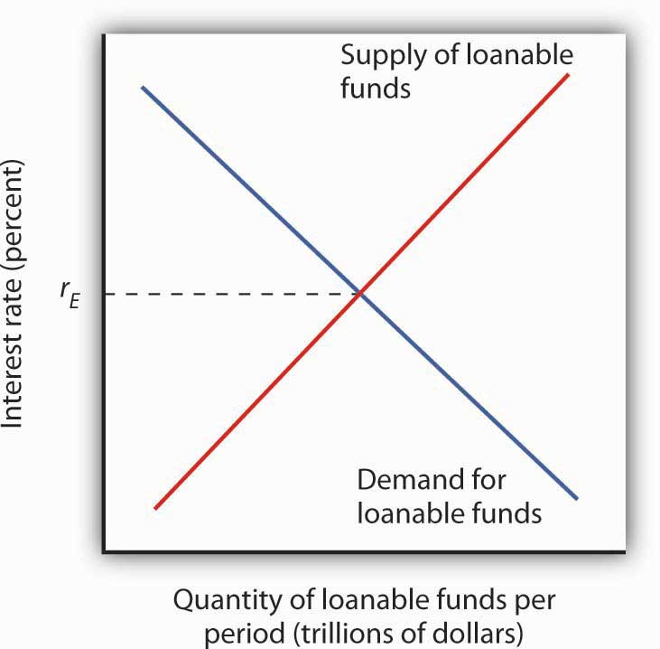
Equilibrium in the Loanable Funds Market
Savings = Investment

Slide 17
Government in the Loanable Fund

Slide 18
Government Budget Balance and Deman of Loan
Budget Balance=Government Revenue−Government Expenditure
Budget surplus
Balanced budget
Budget deficit

Slide 19

Budget Deficit and Surplus Budget
Budget surplus
↓
National saving ↑
↓
Supply of loanable funds ↑
↓
Real interest rate ↓
↓
Investment ↑
Government deficit↑
↓
$$Government borrowing↑$$
↓
$$Demand for loanable funds↑$$
↓
$$Real interest rate↑$$
↓
Private investment↓
Crowding Out

Slide 20
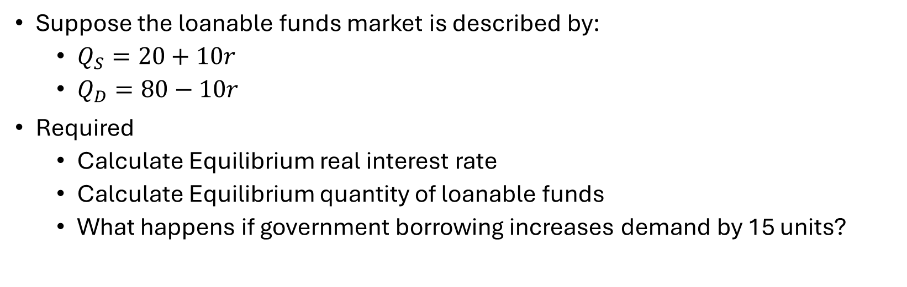
Exercise
Suppose the loanable funds market is described by:
  $Q_{S}=20+10r$
  $Q_{D}=80−10r$
Required
  Calculate Equilibrium real interest rate
  Calculate Equilibrium quantity of loanable funds
  What happens if government borrowing increases demand by 15 units?

Slide 21
Ricardo–Barro Effect
Budget deficits may have little or no effect on interest rates and investment, although the full neutrality assumption is generally regarded as a strong one.
Budget deficit ↑
Future taxes expected ↑
Private saving ↑
Supply of loanable funds ↑
Interest-rate pressure may be offset.

